Slide 1

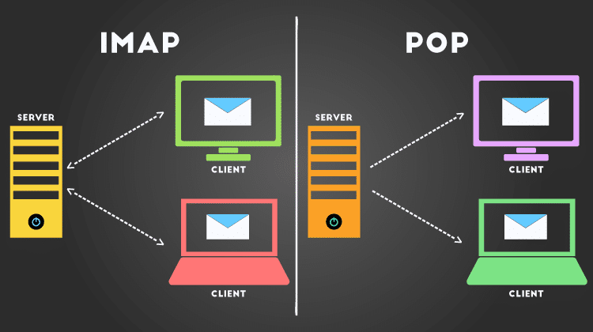
POP & IMAP
Presenters:
Sumit Hajong.
Mebalapynhun Shylla.
MCA 4th Semester.

Slide 2
pop
POP - Post Office Protocol
It was created in 1984 as a means to download emails from a remote server
The original protocol is POP.
One way communication.
Port no-110
Uses a third party application. Examples of such applications are Outlook, Thunderbird, Eudora, GNUMail, or (Mac) Mail.

Slide 3
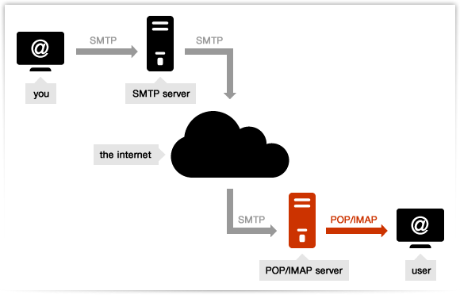
pop

Slide 4
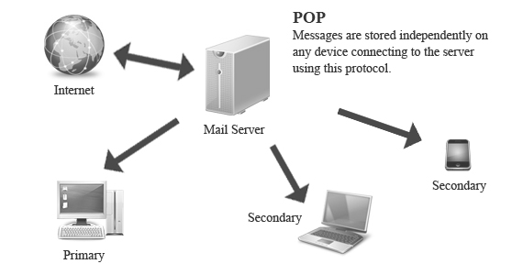
pop
Once the connection has been established, the POP3 protocol goes through three states in sequence:
1. Authorization.
2. Transactions.
3. Update.
The authorization state deals with having the user log in.
The transaction state deals with the user collecting the e-mails and marking them for deletion from the mailbox.
The update state actually causes the e-mails to be deleted.

Slide 5
POP Workflow
Connect to server.
Retrieve all mail.
Store locally as new mail.
Delete mail from server*.
Disconnect.
The default behavior of POP is to delete mail from the server..

Slide 6
What Are the Advantages of POP?
Mail stored locally, i.e. always accessible, even without internet connection.
Internet connection needed only for sending and receiving mail.
Saves server storage space.
Option to leave copy of mail on server.
Consolidate multiple email accounts and servers into one inbox.

Slide 7
IMAP
IMAP - Internet Message Access Protocol.
IMAP was designed in 1986 to allow remote access to emails stored on a remote server.
Two way communication.
Port no- 143
uses a third party application. Examples of such applications are Outlook, Thunderbird, Eudora, GNUMail, or (Mac) Mail.

Slide 8
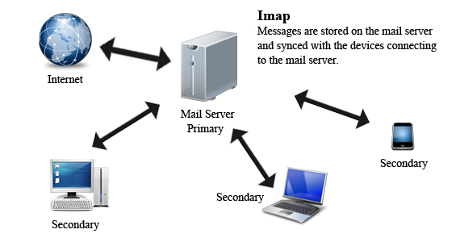
IMAP

Slide 9
IMAP Workflow:
Connect to server.
Fetch user requested content and cache it locally, e.g. list of new mail, message summaries, or content of explicitly selected emails.
Process user edits, e.g. marking email as read, deleting email, etc.
Disconnect.

Slide 10
What Are the Advantages of IMAP?
Mail stored on remote server, i.e. accessible from multiple different locations.
Internet connection needed to access mail.
Faster overview as only headers are downloaded until content is explicitly requested.
Continunig………….

Slide 11
Advantages of IMAP…
Mail is automatically backed up if server is managed properly.
Saves local storage space.
Option to store mail locally.

Slide 12
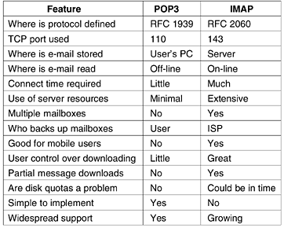
Comparison

Slide 13
REFERENCES
http://www.makeuseof.com/tag/pop-vs-imap/
http://www.fastwebhost.in/blog/email-pop3-imap-and-smtp-port-numbers/
http://smallbusiness.chron.com/gmail-pop-imap-62330.html
Computer Nteworks(5th Edition)- Andrew S.Tanenbaum, David J. Wetherall.

Slide 14
Thank you !!!

